Slide 1
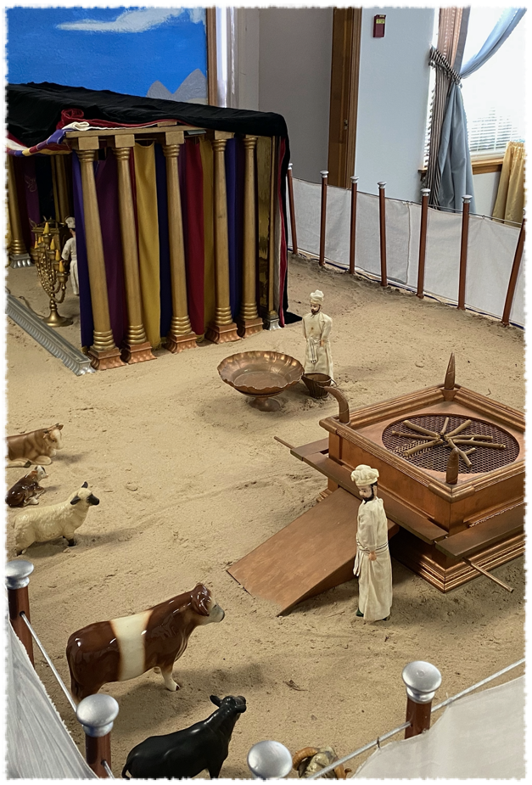
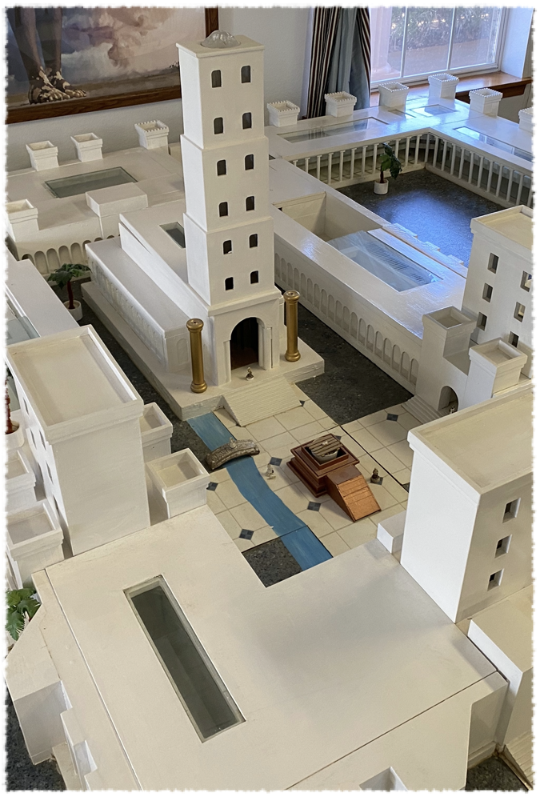
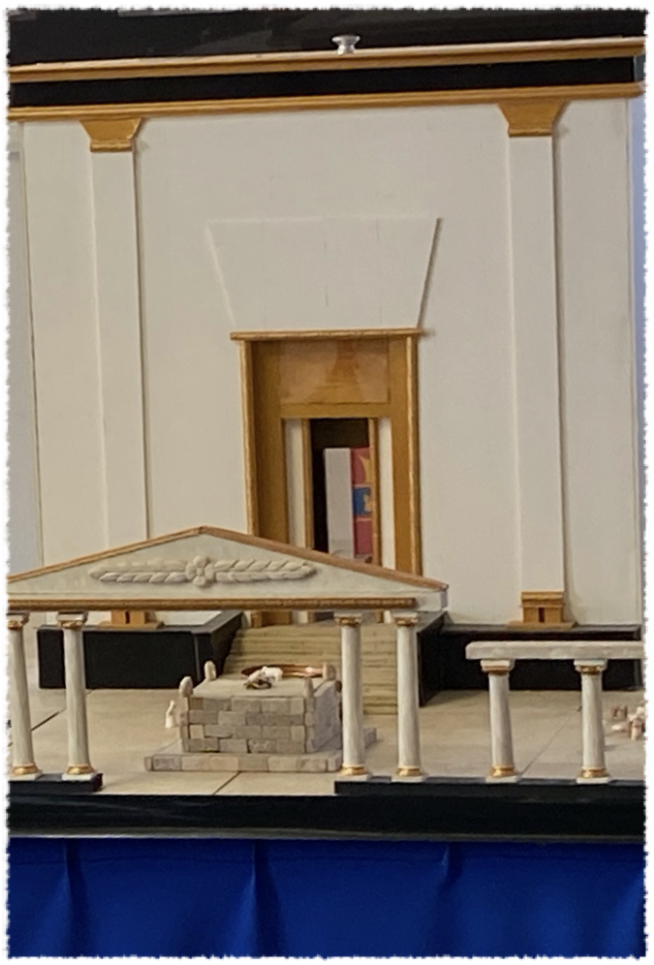
Build Me A Sanctuary

Slide 2
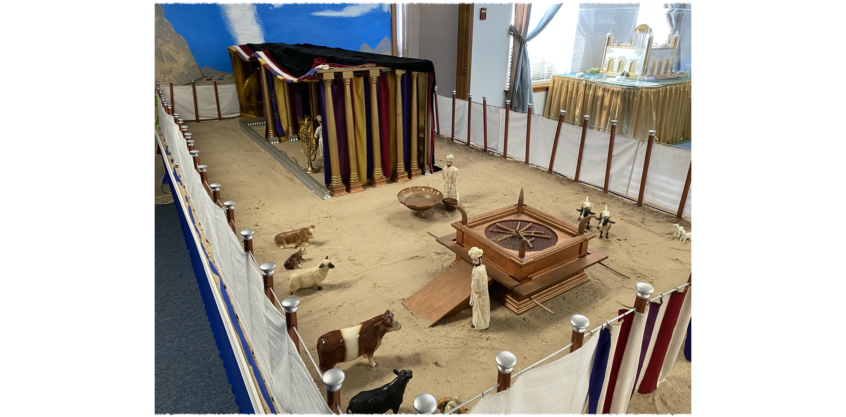
Wilderness Sanctuary
And let them make Me a sanctuary,
that I may dwell among them.” Exodus 25:8

Slide 3
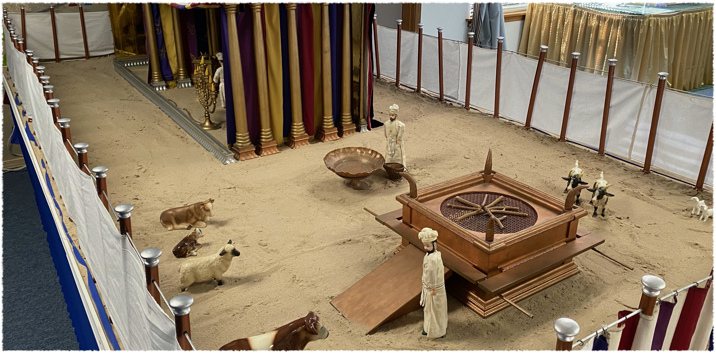
Wilderness Sanctuary: Outer Court
Altar of Sacrifice & Laver

Slide 4
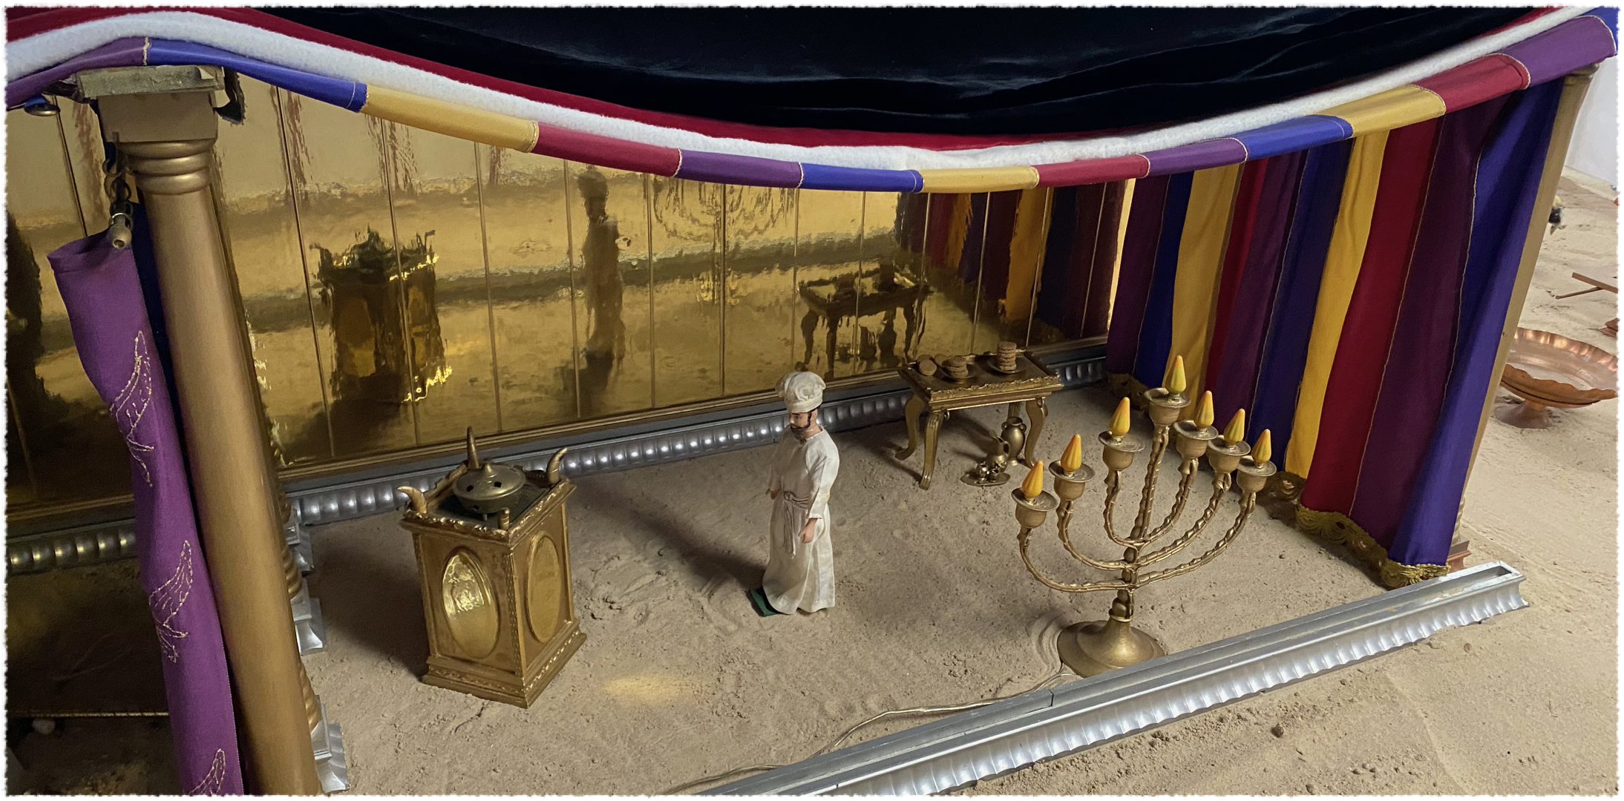
Wilderness Sanctuary: Holy Place
Table of Showbread; 7 Branched Lampstand; Altar of Incense

Slide 5
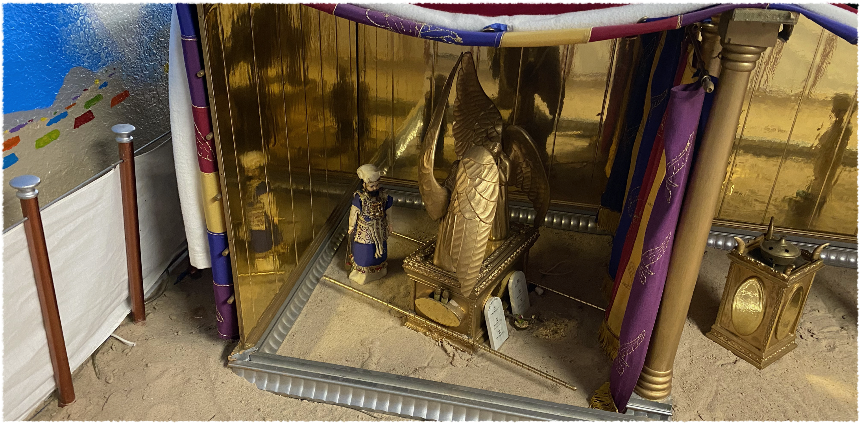
Wilderness Sanctuary: Most Holy
Ark of the Covenant

Slide 6
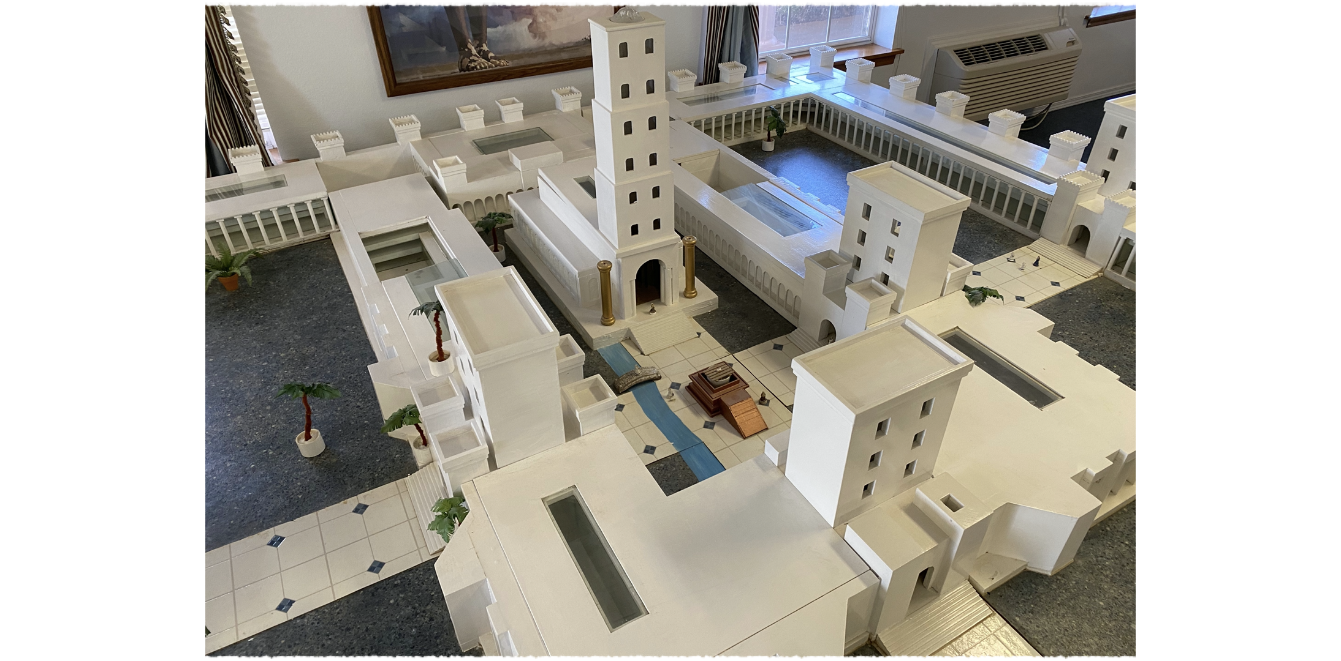
Solomon’s Temple

Slide 7
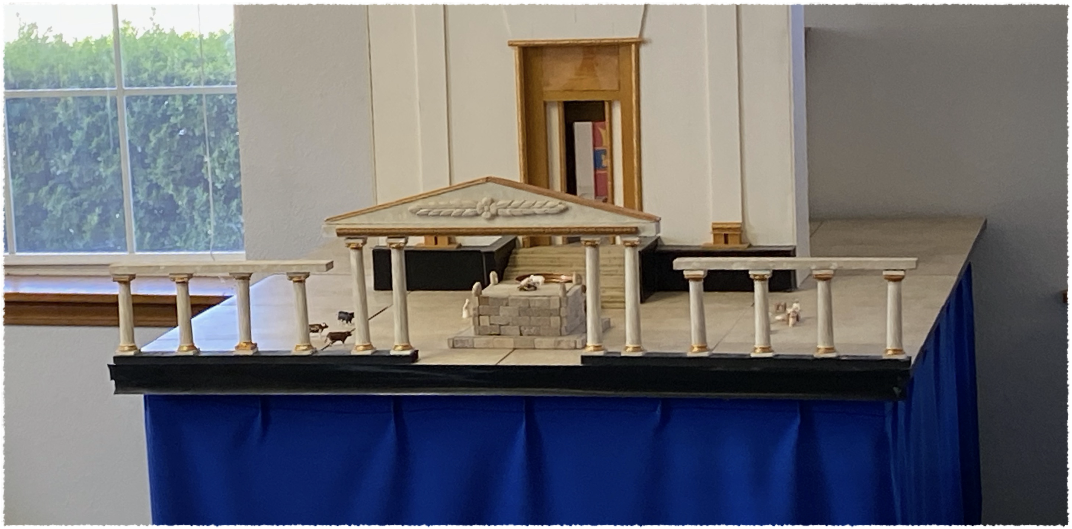
Zerubbabel’s Temple

Slide 8
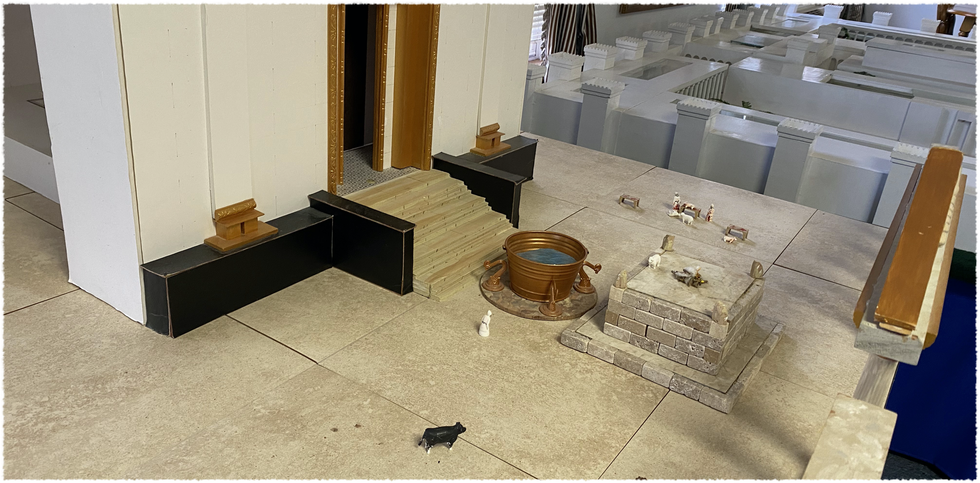
Zerubbabel’s Temple
Outer Court

Slide 9
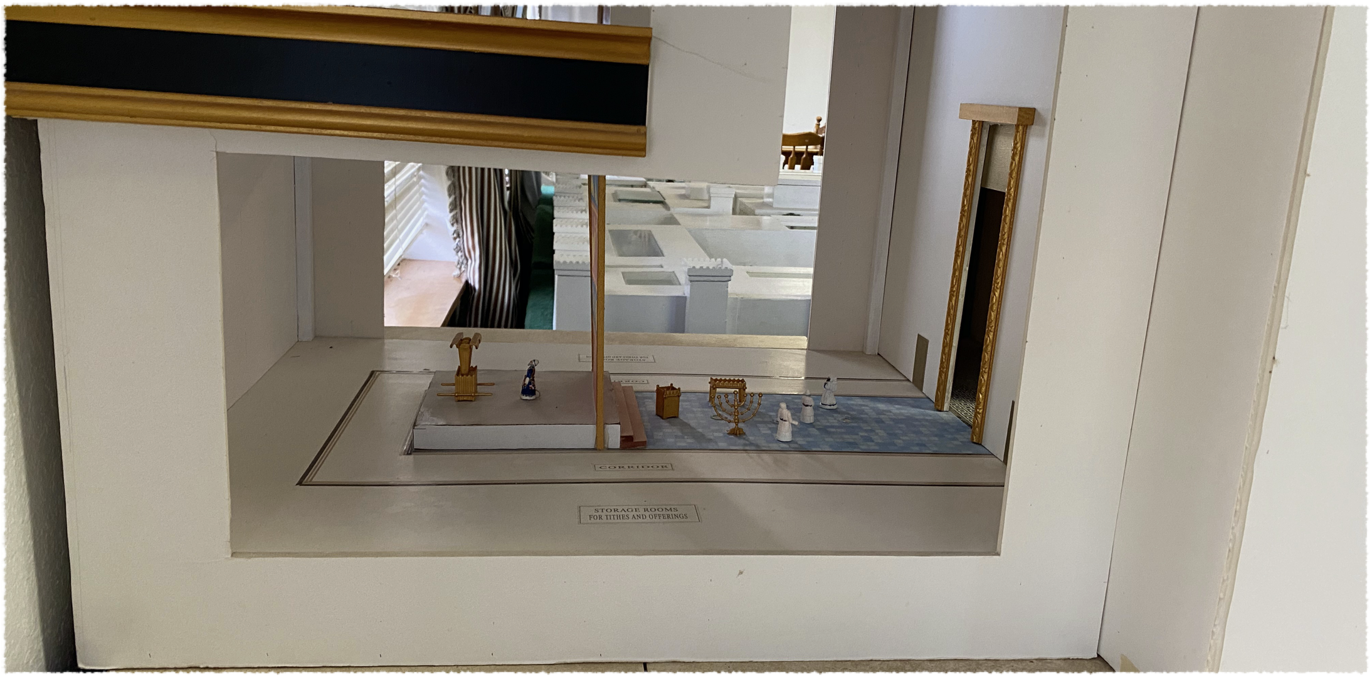
Zerubbabel’s Temple
Most Holy & Holy Place

Slide 10
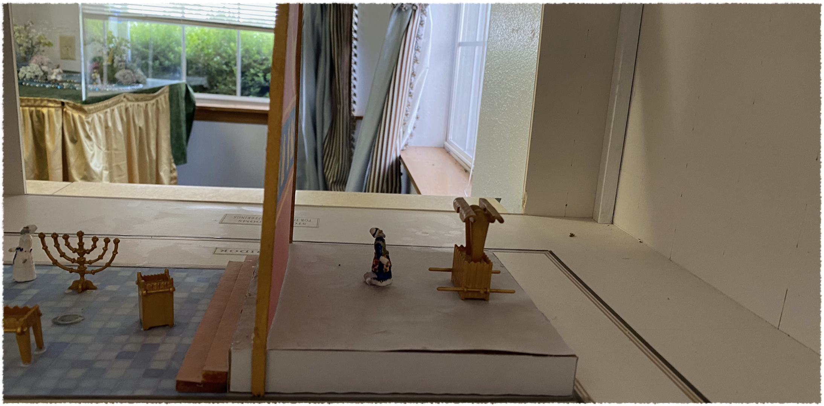
Zerubbabel’s Temple
Most Holy Place

Slide 11
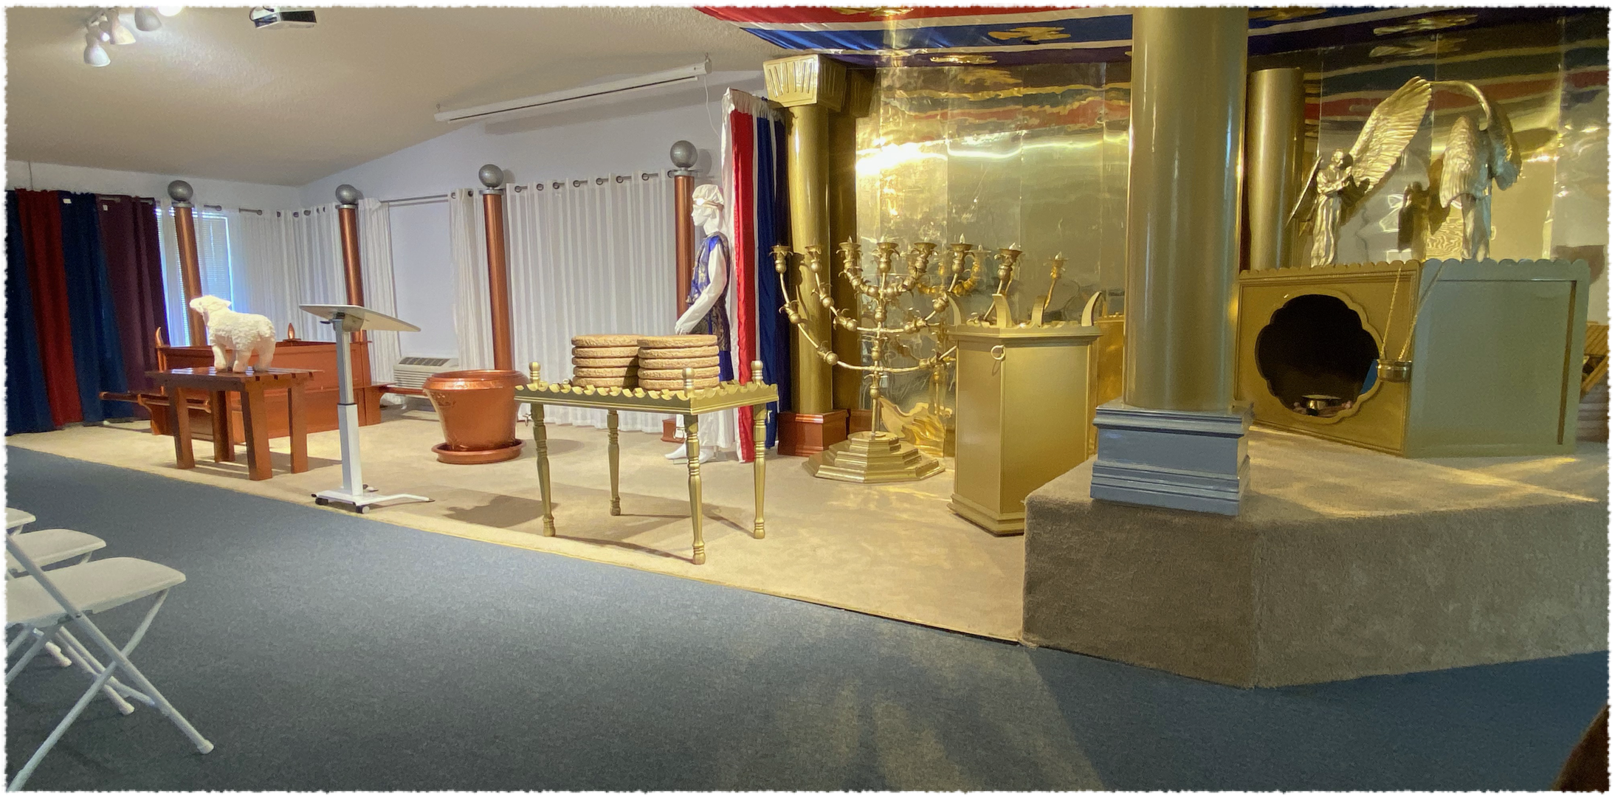
Three Sections in the Sanctuary
Outer Court - Holy Place - Most Holy Place

Slide 12
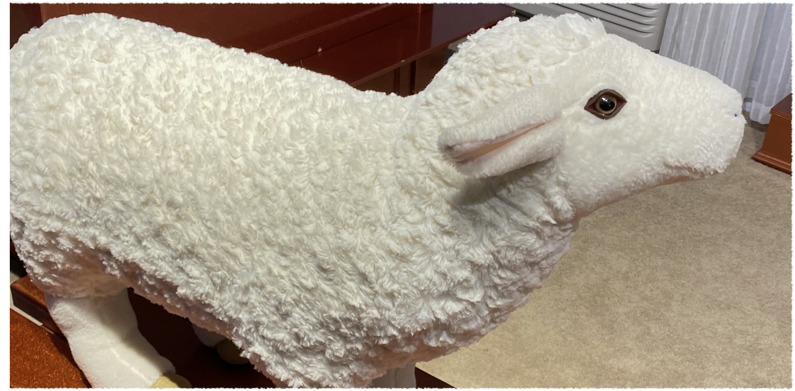
A Lamb Was Sacrificed
It represented the “Lamb of God.”

Slide 13
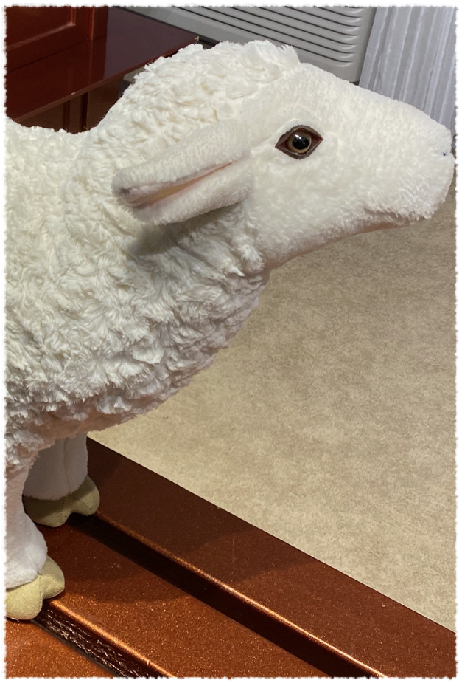
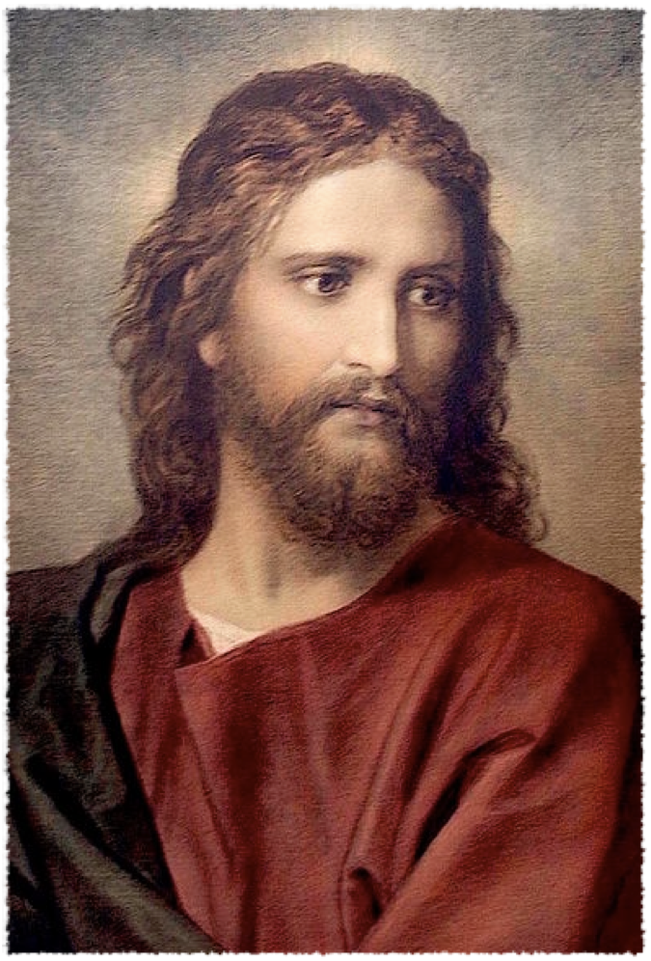
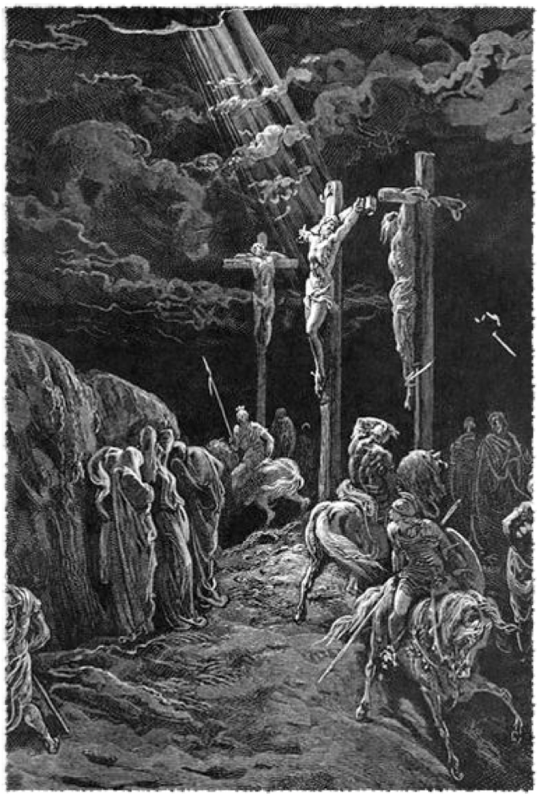
Christ Our Passover
Christ was our sacrifice

Slide 14
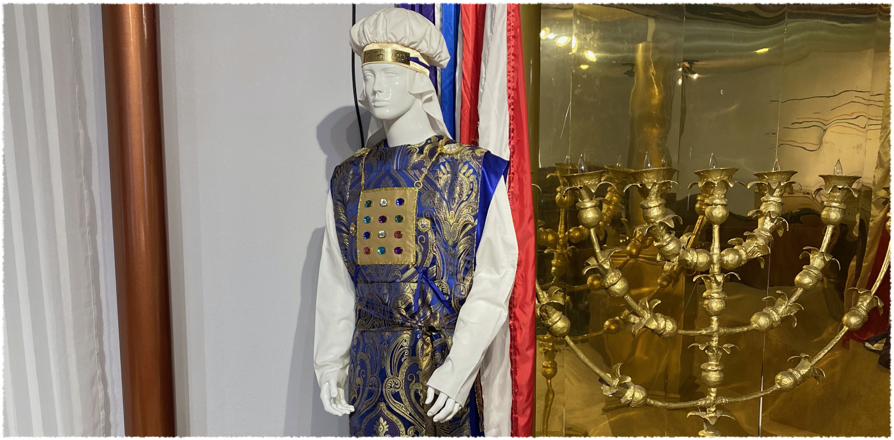
A Priest Officiated in the Sanctuary
Christ is our Priest in the Heavenly Sanctuary

Slide 15
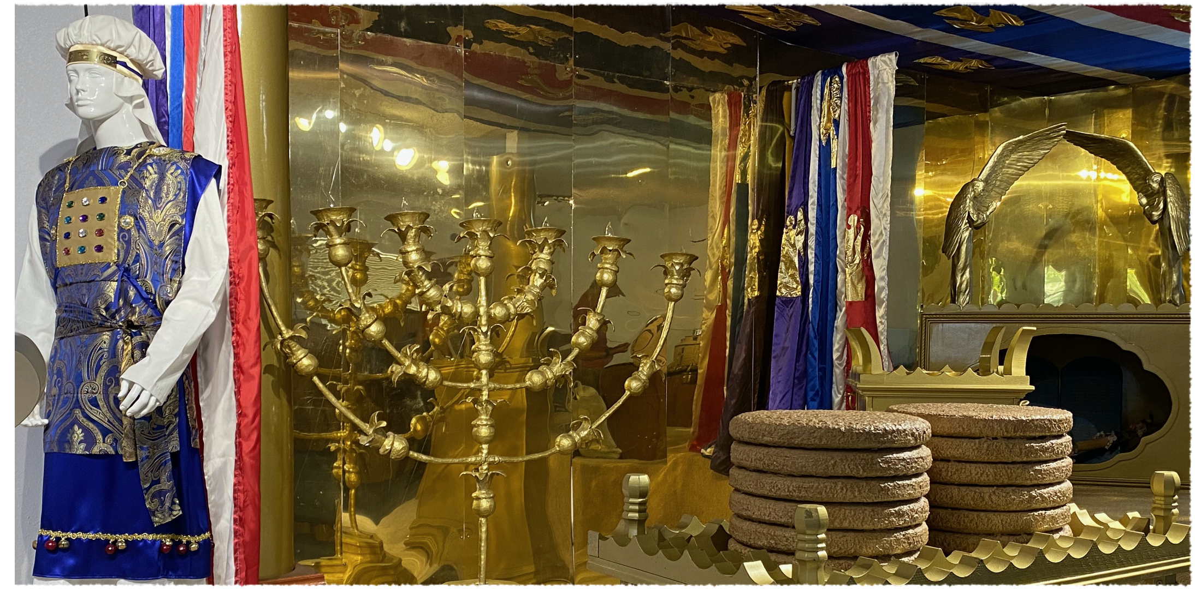
Sanctuary Furniture

Slide 16
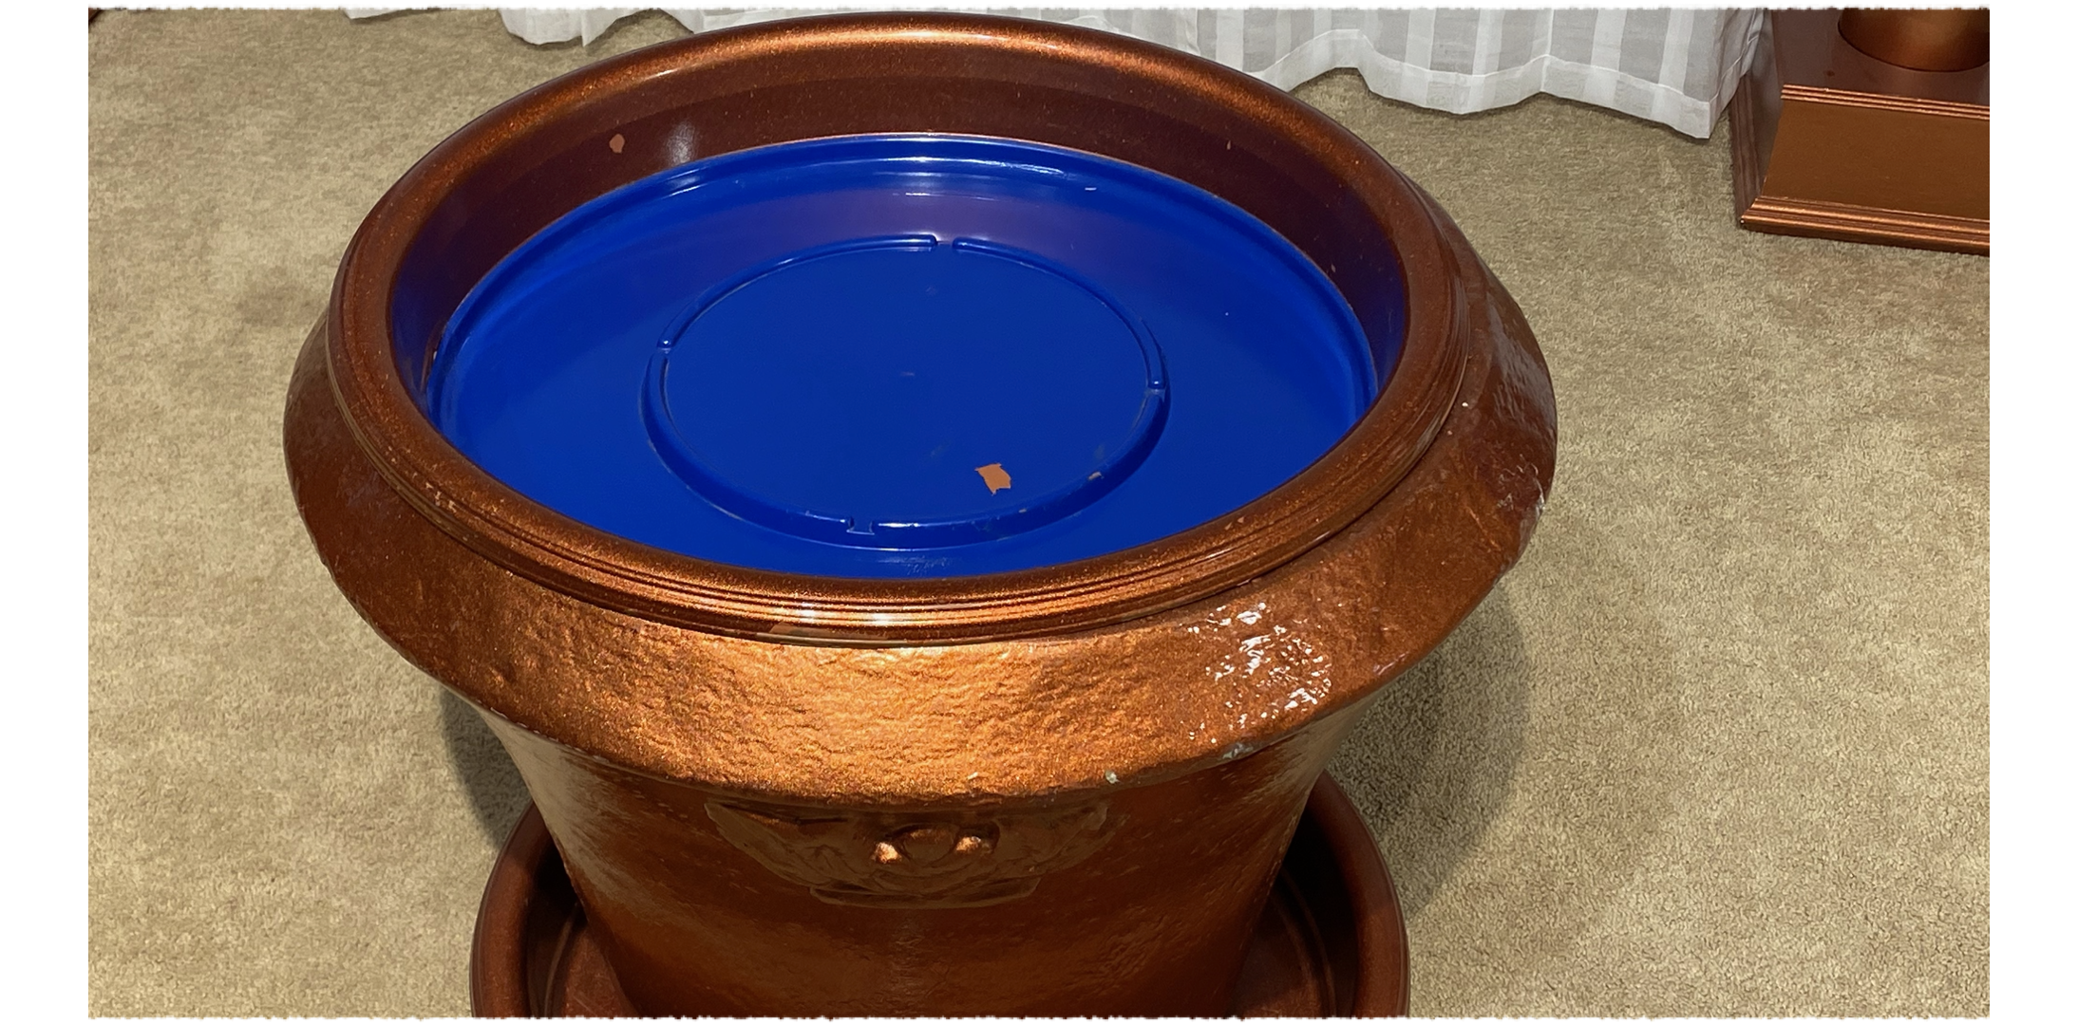
Outer Court Furniture
Laver

Slide 17
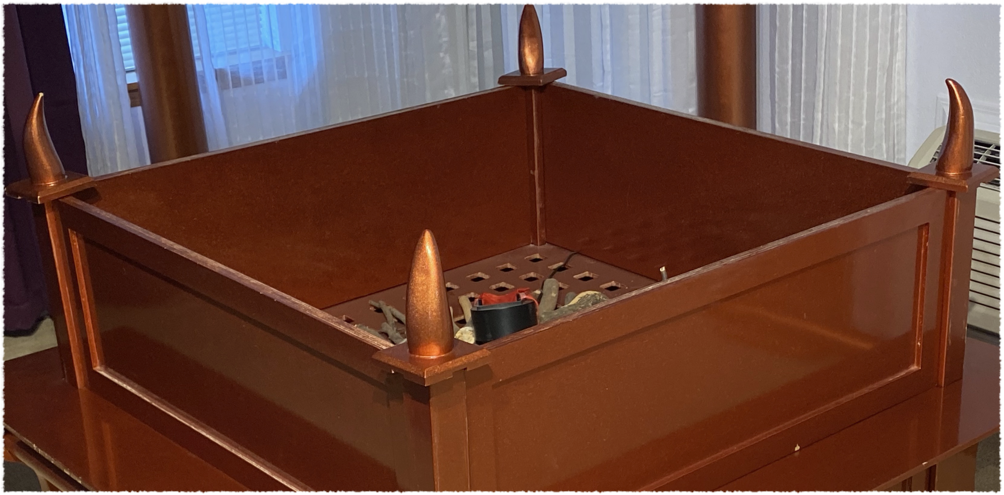
Outer Court Furniture
Altar of Sacrifice

Slide 18
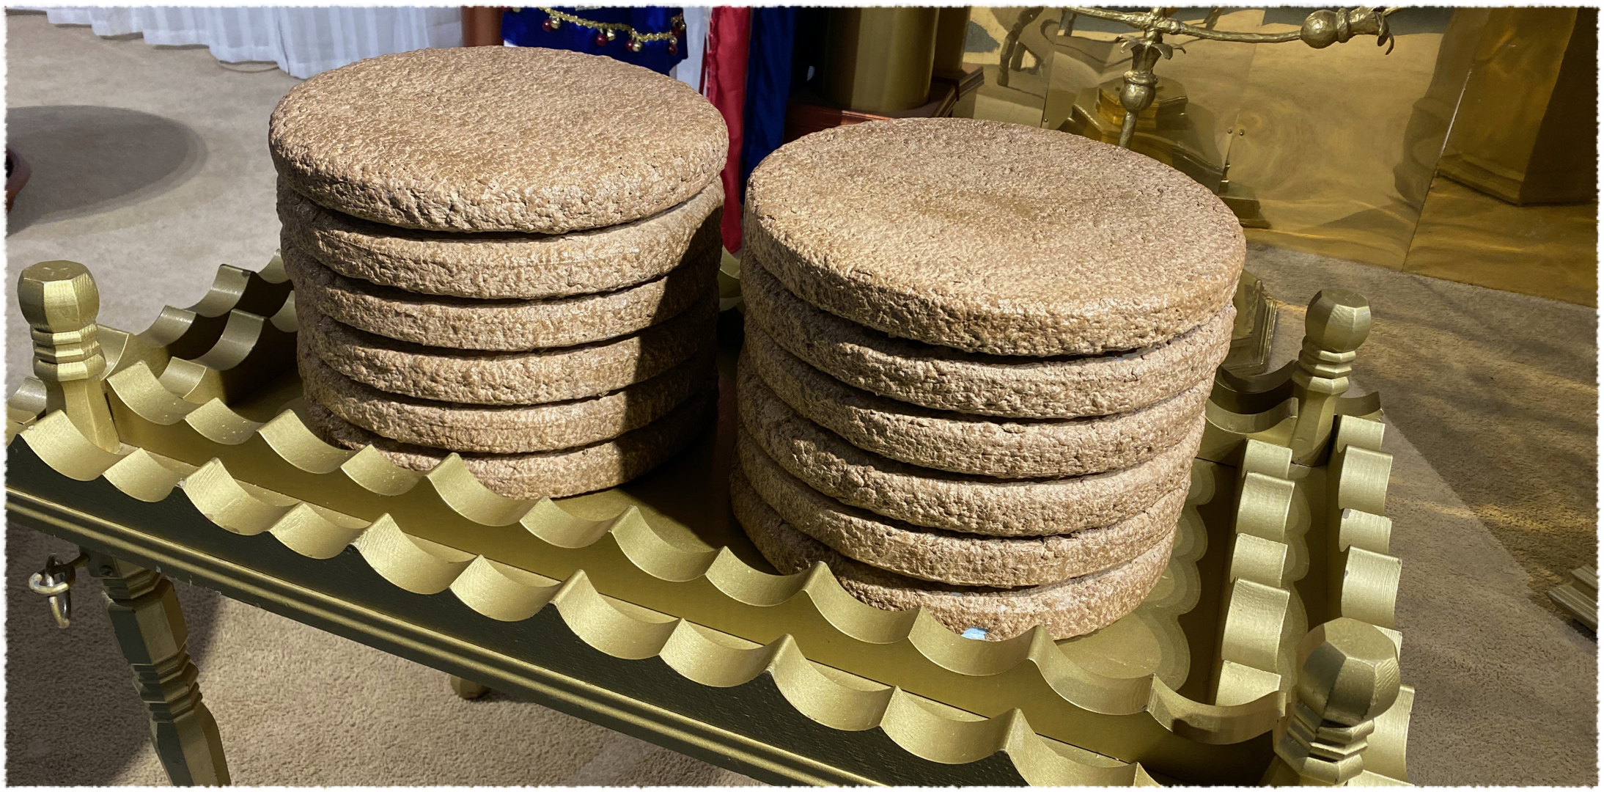
Holy Place Furniture
Table of Show Bread

Slide 19
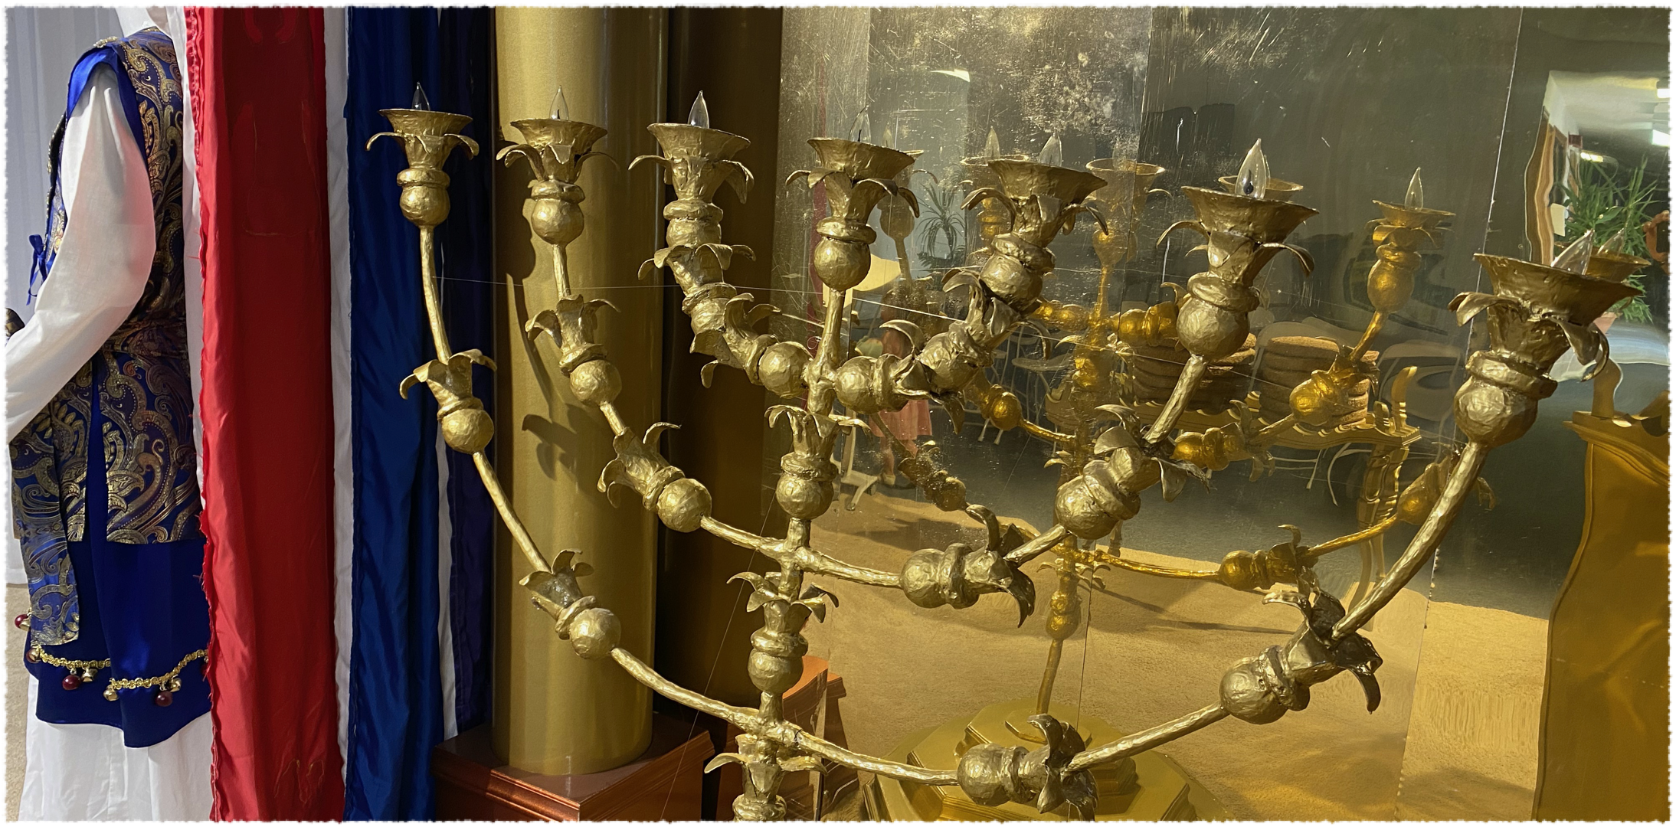
Holy Place Furniture
7 Branched Lampstand

Slide 20
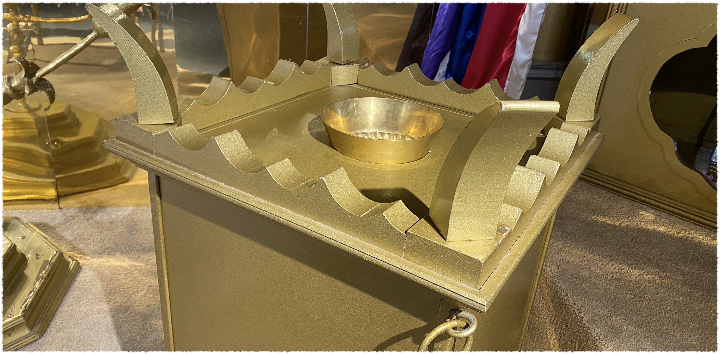
Holy Place Furniture
Altar of Incense

Slide 21
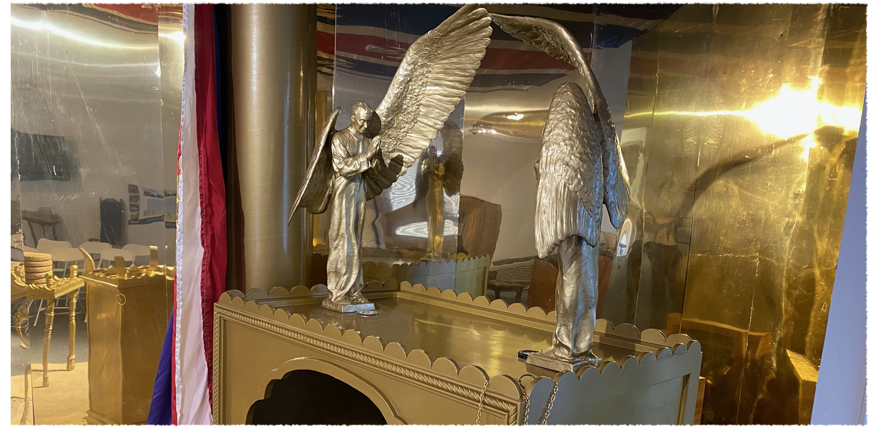
Most Holy Place Furniture
Ark of the Covenant With Mercy Seat

Slide 22
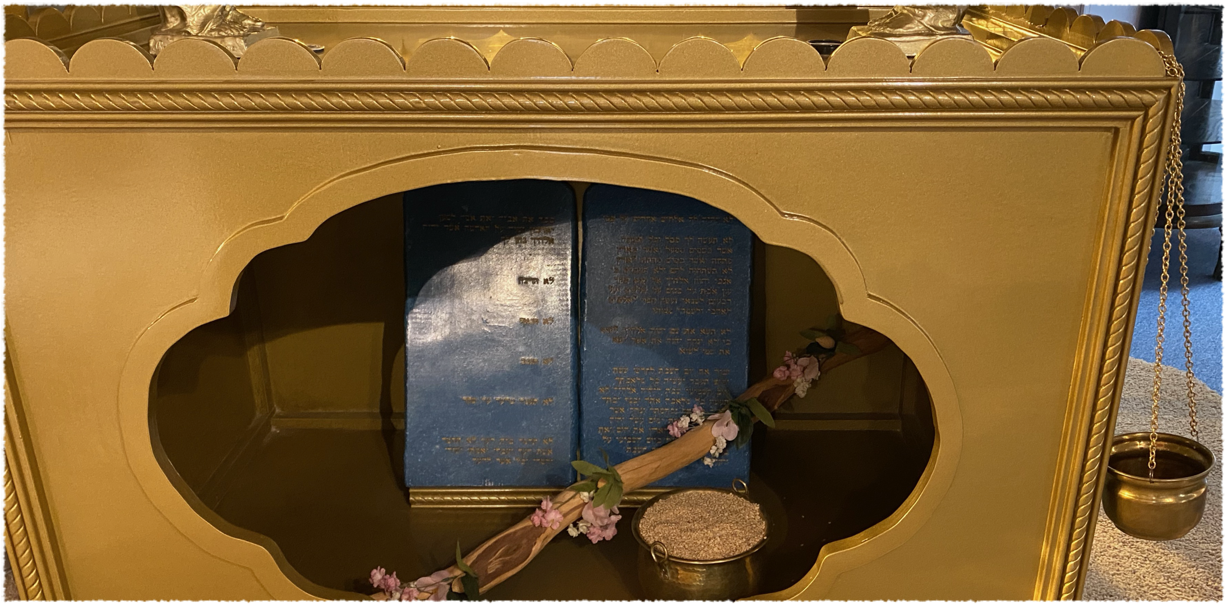
Most Holy Place Furniture
Ten Commandments; Aaron’s Rod; Pot of Manna

Slide 23
The Sanctuary Pointed To Christ
Are you looking to Christ?

Slide 24
Build Me A Sanctuary

